Slide 1
VARDHAMAN COLLEGE OF ENGINEERING DEPARTMENT OF CSE
Mini Project Review - I
Title: Predictive Analytics for Cybercrime Complaints
Team No:
Guide Details
Ms. Ala Sowmya
Assistant Professor
S. No | Roll No | Student Name
1 | 23881A05FK | G. SPANDANA
2 | 23881A05GJ | B. NITHIN BHARADWAJ
3 | 23881A05GJ | P. BIPIN RAJ

Slide 2
Table of Contents
1. Title
2. Background Research
3. Project Planning (Include Gantt Chart)
4. Literature Survey
5. Objectives
6. Project Milestone Tracker
7. Q&A

Slide 3
TITLE
Project Title: Predictive Analytics for Cybercrime Complaints
Domain/Area: Web Based App & Machine Learning
Type: Research + Application
Keywords: Extract features from URL, Train a Random Forest or SVM model on a dataset, Cybercrime prediction, Crime pattern forecasting

Slide 4
BACKGROUND RESEARCH
A browser extension or a web app that analyzes a URL in real-time to determine if it is legitimate or a phishing attempt. Why it’s impressive: Cybersecurity is a hot field. Using ML to predict security threats shows you can apply data science to real-world safety.
Brief overview of existing systems or solutions
Most current cybercrime systems focus on reporting and post-incident investigation. Tools like cybercrime portals, SIEM platforms, and basic dashboards provide incident logs, alerts, and historical statistics. While useful, they mainly support reactive cybersecurity, offering limited forecasting or predictive insights.

Slide 5
Identify gaps or challenges in existing work
No predictive analysis to forecast future cybercrime trends or hotspots.
Limited integration of temporal, spatial, and behavioral data.
Lack of unified frameworks combining classification, forecasting, and geospatial modeling.
Dashboards are mostly static, offering minimal actionable intelligence.
Motivation behind the proposed work
Cybercrime is increasing quickly, requiring a move from reactive to proactive approaches. A predictive system can help law enforcement anticipate incidents, identify hotspots, and allocate resources better. This project addresses existing gaps by offering integrated predictions and an interactive dashboard for smarter decision-making.

Slide 6
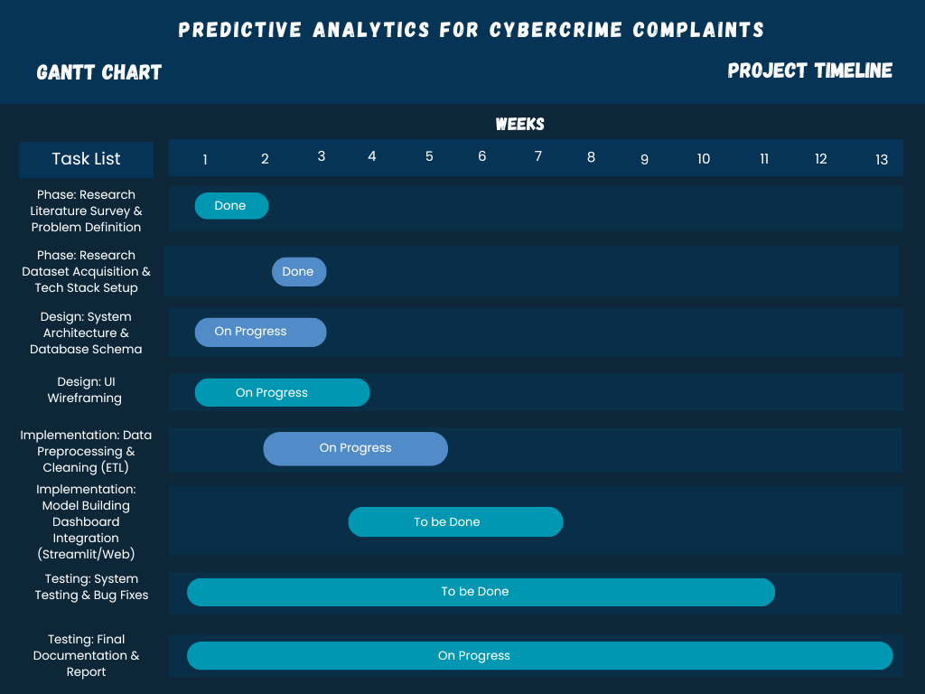
PROJECT PLANNING

Slide 7
LITERATURE SURVEY
Paper Title | Approach/Algorithm | Dataset Used | Key Findings | Gaps Identified
Computational System to Classify Cyber Crime Offenses using Machine Learning (2020) | Support Vector Machine (SVM), Random Forest, and Decision Trees for text classification. | Kaggle Cybercrime Datasets. | SVM achieved the highest accuracy in distinguishing between "Violent" and "Non-Violent" . | The model relies heavily on structured data and struggles with unstructured text without heavy pre-processing.
Cybercrime: Identification and Prediction Using Machine Learning Techniques (2022) | K-Means Clustering (Unsupervised Learning) & Gaussian Mixture Models. | CBS Open Data StatLine (National Crime Statistics). | Unsupervised clustering identified new patterns of fraud that did not fit into pre-existing categories. | The detection rate for unsupervised methods (76%) was significantly lower than supervised methods.

Slide 8
OBJECTIVES
State clear and measurable objectives:
To develop a predictive model that forecasts future cybercrime incidents using historical complaint data.
To identify geospatial hotspots by applying clustering techniques to detect high-risk regions.
To build an interactive dashboard that visualizes predictions, trends, and risk zones for improved decision-making.

Slide 9
PROJECT MILESTONE TRACKER
Paste Scanned Copy of Handbook Page No:3(Signed)

Slide 10
Q&A

